Slide 1


Forensic Accounting Analysis on Walmart
By: Abe Archer, Coleman Dawkins, Lauren Petty, Isabella Mccoy

Slide 2
Analysis Description / Goals:
Dissect and analyze data on Walmart’s Financials
Create visualizations and assemble our data into something meaningful
Search for anomalies / Find interesting connections between our data
Perform a statistical analysis on our data

Slide 3
Research Objectives:
Isabella
Break down each row of Walmart’s quarterly data and interpret out how they interact with each other
Lauren
View Walmart’s stock price over the ten years and view what causes big jumps in data
Abe
Compare Walmart’s data to a large competitor i.e. Costco
Coleman
Perform a statistical analysis with Benford's Law: tendency for lead digit to be smaller

Slide 4
Walmart Quarterly Analysis
Cleaning the Walmart data
The data was formatted by rows, which made it difficult to analyze in R
Because of this, the data had to be transposed to flip the rows to columns
This was done by reading the data into R, using the t() function to transpose it, and outputting the transposed data into a new .csv file
After this, the dates were reformatted to follow YYYY-MM-DD, which was easier for R to read than the initial MM-DD-YYYY format
The spaces between the data were also deleted for ease of reading

Slide 5
Walmart Quarterly Analysis
The forensic analysis involved examining both individual columns of data as well as how various columns interact with each other
Using boxplots can display the range of data and help identify outliers
Line graphs were also used to examine relationships between multiple variables
All visualizations were done in R, using GGplot

Slide 6
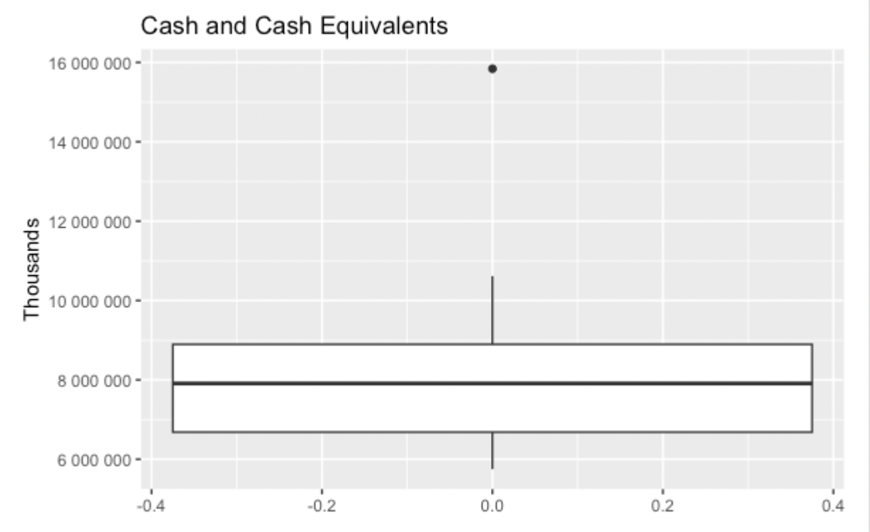
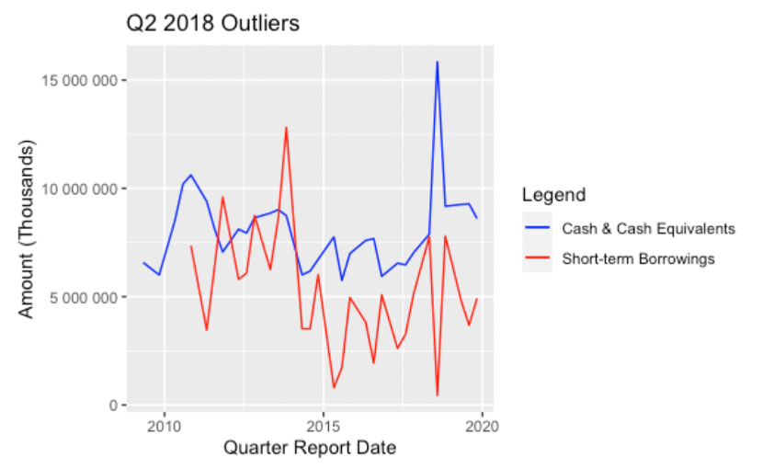
Outliers
One outlier exists in Cash and Cash Equivalents
In the second quarter of 2018, a value of $15,840,000,000 was reported
This quarter also had another outlier, with significantly lower short-term borrowings than any other reported at $444,000,000

Slide 7
Where is Fraud Likely?
Generally, most financial statement fraud occurs in the reporting of revenue, assets, and liabilities
Using this information, we can pay particular attention to the assets and liabilities recorded in this dataset
This can be further broken down into total assets and total current assets, with the difference being that total current assets are those that will provide value within a year and total assets being all held assets

Slide 8
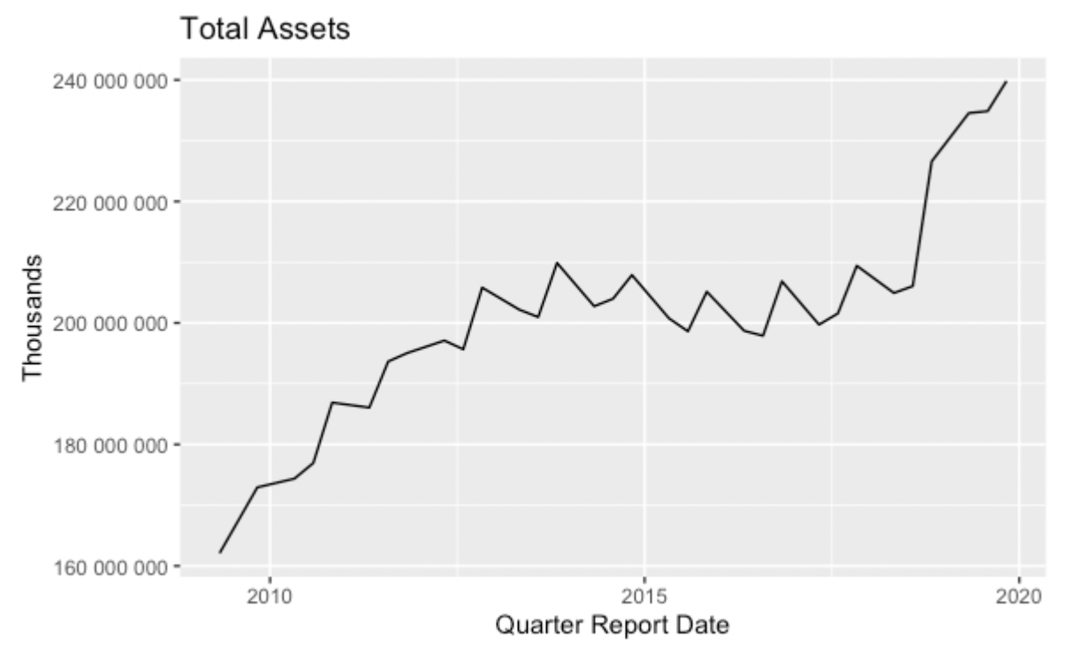
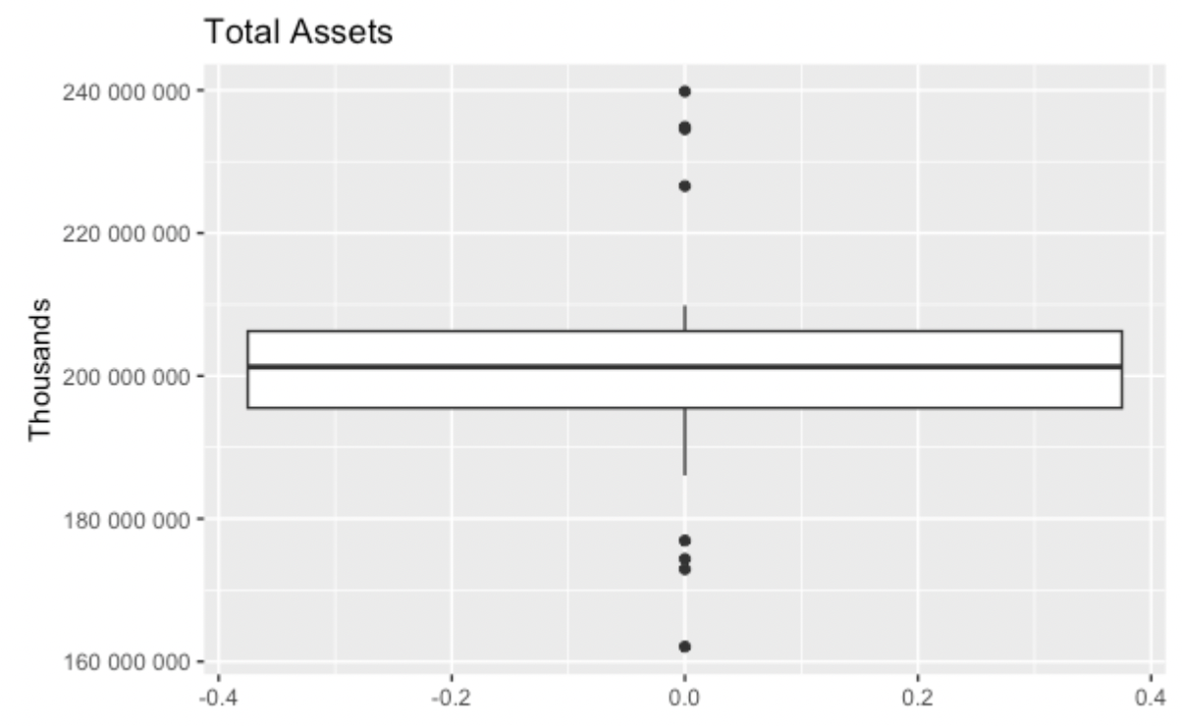


Slide 9
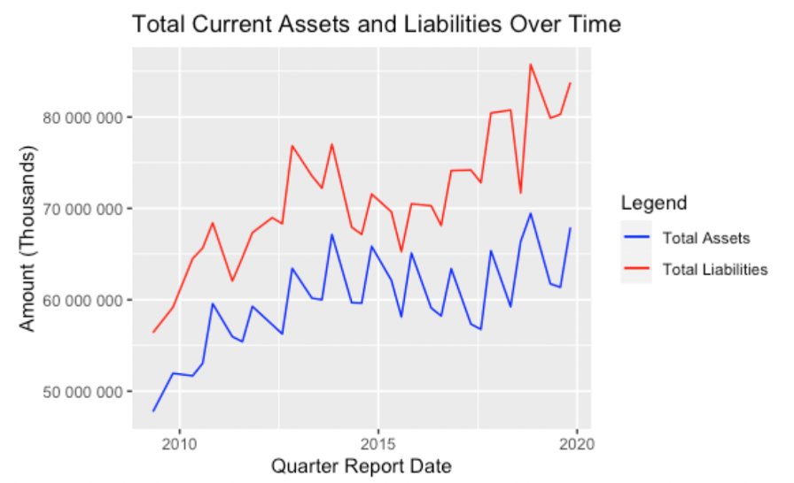




Slide 10
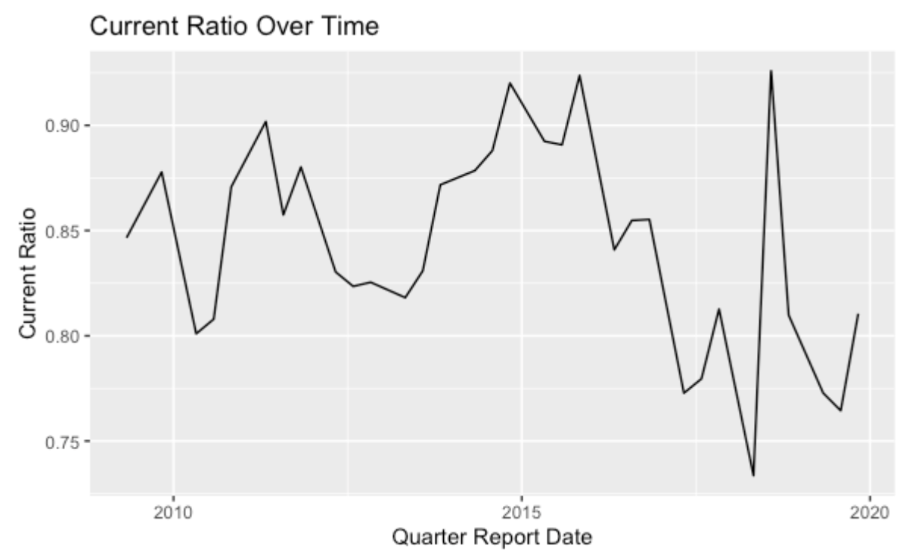



Slide 11
Walmart Stock History
Graphing Walmart’s stock price from 2009-2019 in R.
Calculating correlation values between balance sheet items in R.
Explaining key financial ratios, retained earnings (accumulated deficit), total shareholders’ equity (deficit), and dividend policy.

Slide 12
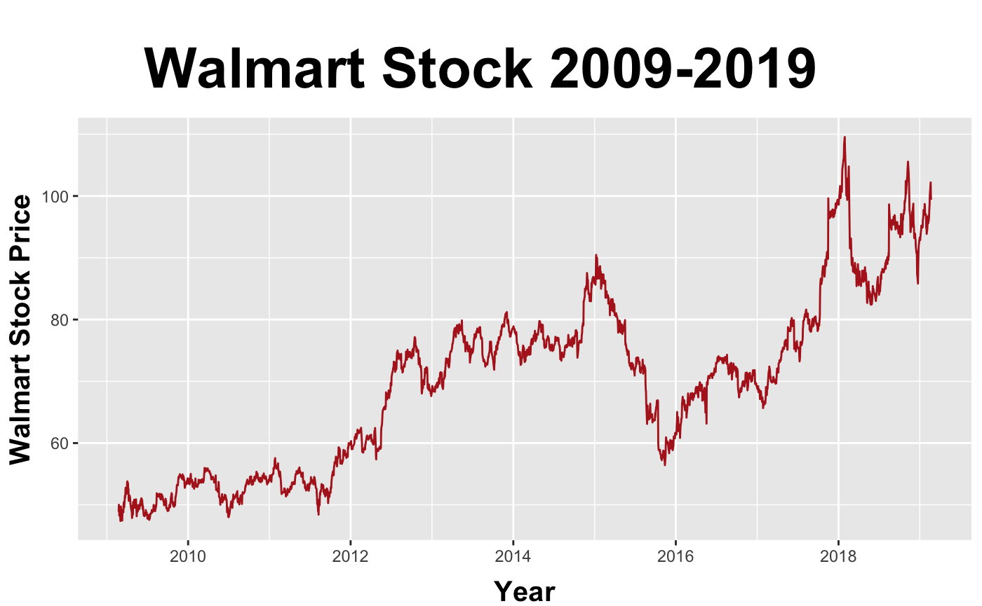
Notes:
Walmart Inc. (WMT) stock price, news, quote & history - Yahoo Finance. (n.d.). https://finance.yahoo.com/quote/WMT/

Slide 13
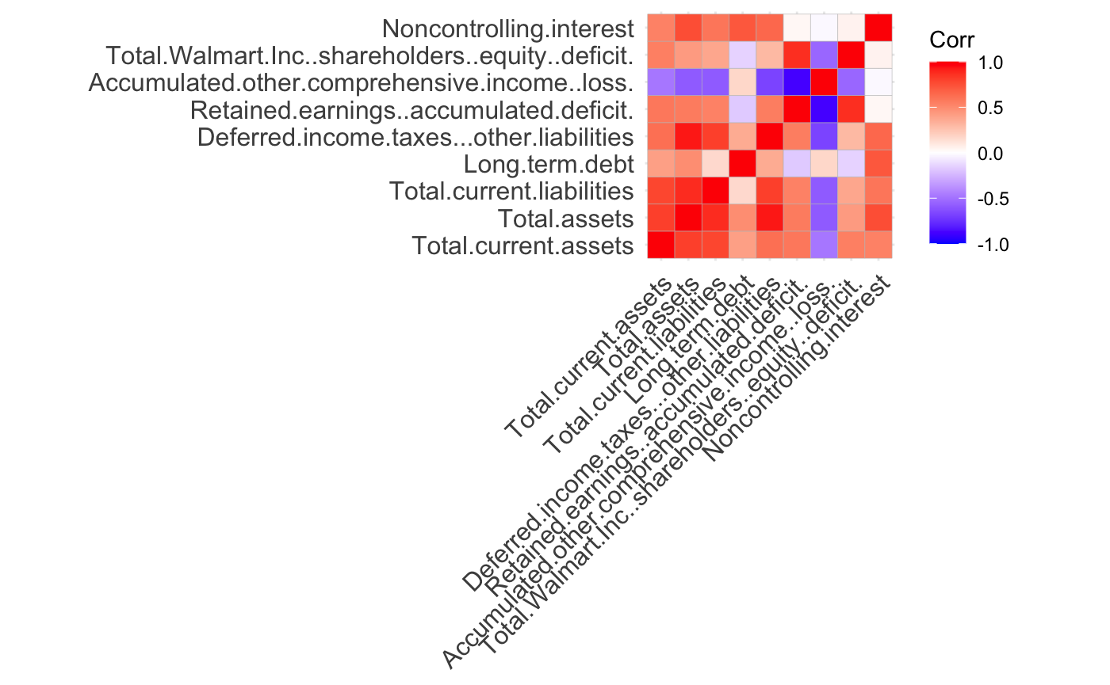

Slide 14
Stock Price and Correlation Values Elaboration
Retained earnings are the cumulative net earnings or profits of a company after any dividend payments.
- Dividends are a component of stockholders’ equity.
- Decreases when a company loses money or pays out dividends.
- Walmart has issued dividend payments 4 times each year from 2009 to 2019.
Return on Equity (ROE) measures a company’s earnings relative to the money it keeps within the business. In 2019 ROE was 12%. Also, the debt to equity ratio is 0.78.
- The ROE ratio is standard for the industry.
-Modest amount of debt can grow company.
Notes:
Yahoo! (n.d.). A note on Walmart Inc.’s (NYSE:WMT) roe and debt to equity. Yahoo! Finance. https://finance.yahoo.com/news/note-walmart-inc-nyse-wmt-095520157.html

Slide 15
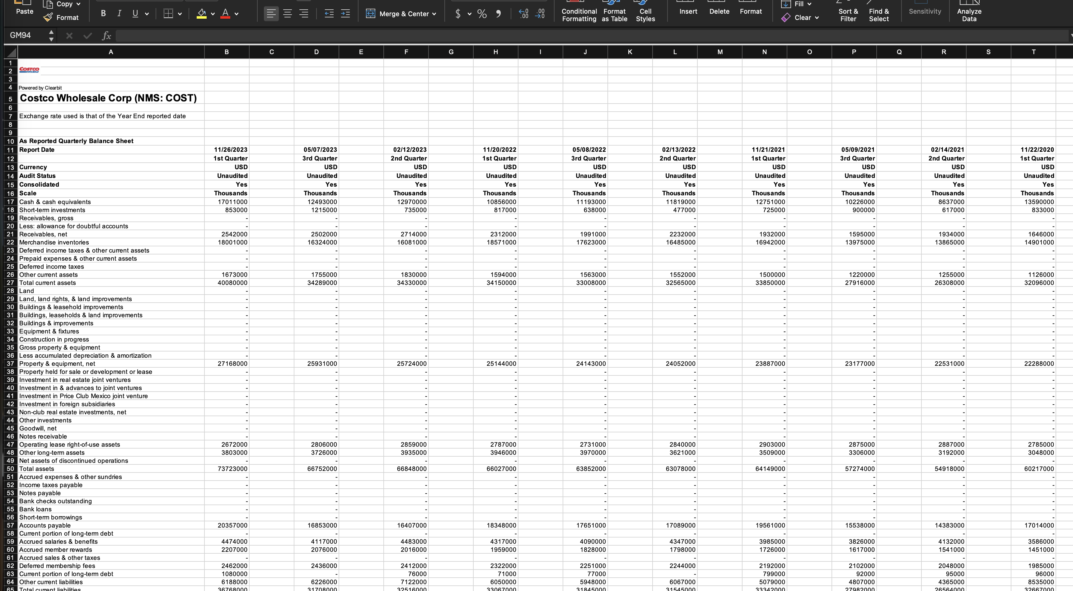
Costco Quarterly Analysis / Comparison
Data Cleaning/Interpretation
Row Reformatting
Spacing Errors
File Differences

Slide 16
Outliers:
Outlier at 11/24/2019 of 9,027,000 (Thousand Dollars)
Closest Value is at 5/12/2019 of 7,013,000 (Thousand Dollars)
(Cash Equivalents in Thousands)

Slide 17
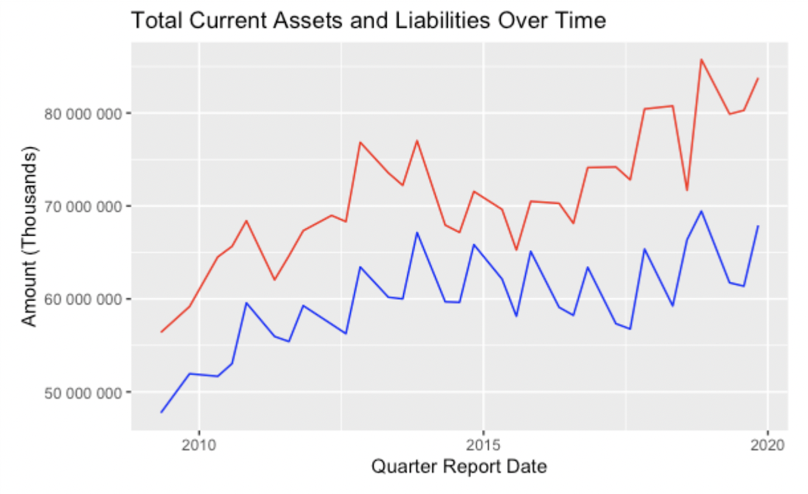
Comparisons Between Walmart and Costco
Red = Liabilities / Blue = Total Assets

Slide 18
Comparisons Between Walmart and Costco
Different rates of Growth
Potential Factors

Slide 19
Interesting Correlations:
Relatively Similar Growth Patterns between Stock, Assets, and Liabilities

Slide 20
Benford's Law Analysis
What is Benford's Law?
P(d) = Log10(1+1/d)
How is it used in forensic accounting?
How does Walmart’s data follow Benford’s Law?

Slide 21
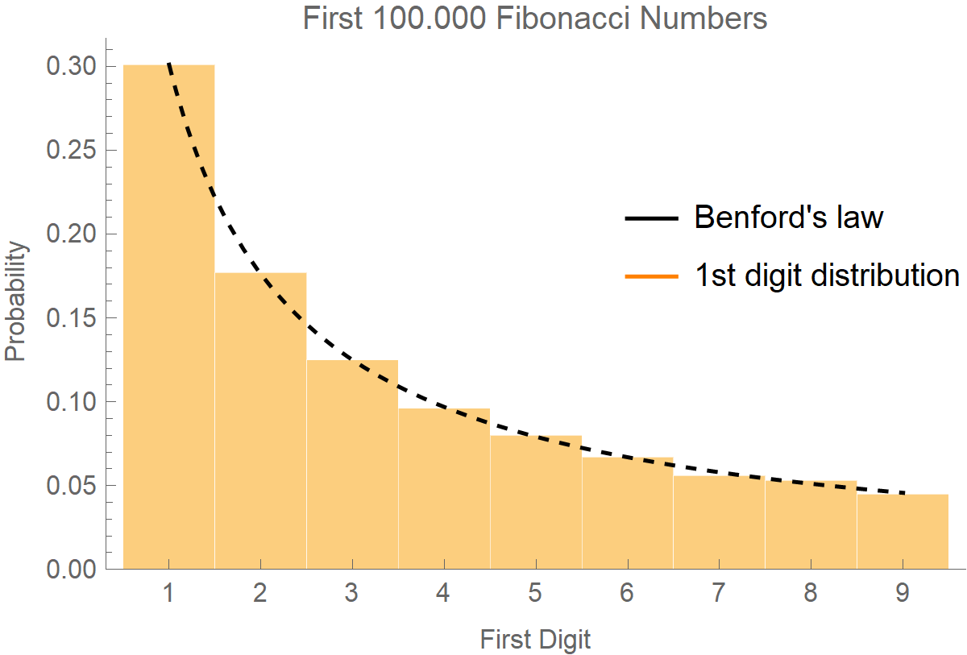
What is Benford’s Law?
If the distribution of digits in a data set were even, then the proportion of each digit would be roughly 11.1%.
The real proportion can be found by this equation:
P(d) = Log10(1+1/d)

Slide 22

How has Benford’s Law been used?
Bernie Madoff was a chairman at the Nasdaq stock exchange.
Between the years of 1990 and 2008, Madoff fabricated thousands of balance sheets over reporting returns on investments.

Slide 23
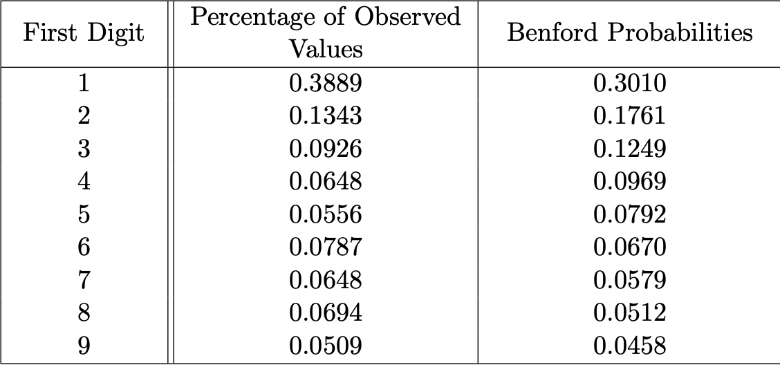
Madoff’s Balance Sheet:
These numbers were calculated by Juan Chang in 2017 as a part of his dissertation about Benford’s law.

Slide 24
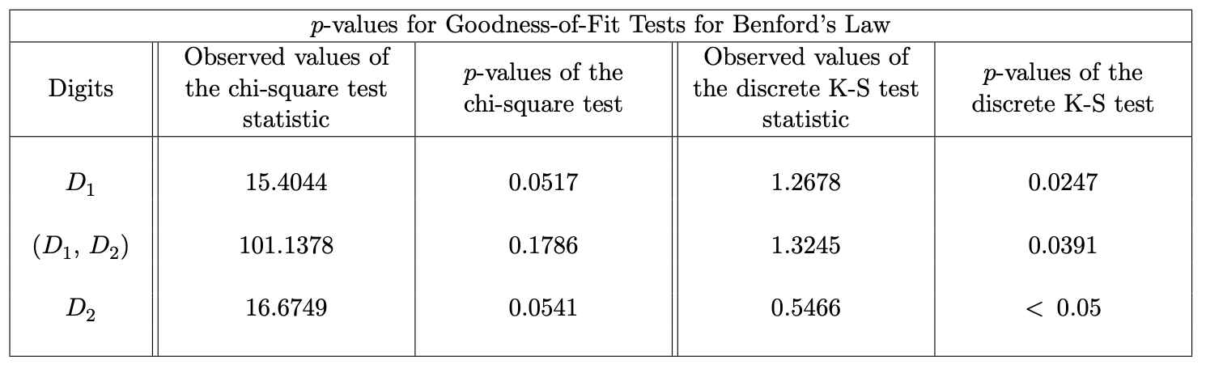
Kolmogorov-Smirnov test vs Chi Square test
Kolmogorov-Smirnov test (or KS test) and Chi Square test are both tests for goodness of fit.
KS test quantifies the cumulative distance between a numeric vector and its predicted equation.
Chi Square test examines the difference between 2 categorical variables.

Slide 25
Does Walmart’s Data Match Benford’s Law?
Read our Walmart data from 2009 to 2019 into R studio into a numeric vector. Then the package Benford.analysis was used. The following statistics were calculated:
First Digit:
X-squared = 140.09, df = 8, p-value < 2.2e-16
Mean Absolute Deviation (MAD): 0.03512796 MAD Conformity - Nigrini (2012): Nonconformity Distortion Factor: 9.88323
First and Second Digit:
X-squared = 296.78, df = 89, p-value < 2.2e-16
Mean Absolute Deviation (MAD): 0.00456162
MAD Conformity - Nigrini (2012): Nonconformity
Distortion Factor: 9.88323
Notes:
Read our Walmart data from 2009 to 2019 into R studio into a numeric vector. Benford’s Law analysis does not care what the numbers mean, just that they match the given proportion.
The package Benford.analysis was used to calculate initial Chi Square test. Due to the inaccuracies of the P value for Chi Square when performing Benford’s Law’ analysis, R calculates a Mean Absolute Deviation of .035, meaning generally nonconformity to Benford’s law.

Slide 26
Kolmogorov-Smirnov Test
Using the BenfordTests package in R, the data was fed into the following function:
ks.benftest(x = V, digits = 1, pvalmethod = "simulate", pvalsims = 10000)
Then the following D-Statistic and P-Value were calculated for the first 2 digits:
D = 23.001, p-value < 2.2e-16
Using a significance level of 1% with an alpha of .01 with our calculated P value of 2.2e-16, we reject H0. There is significant statistical evidence that Walmart’s data does not conform to Benford’s law with a significance level 0f 99%.

Slide 27
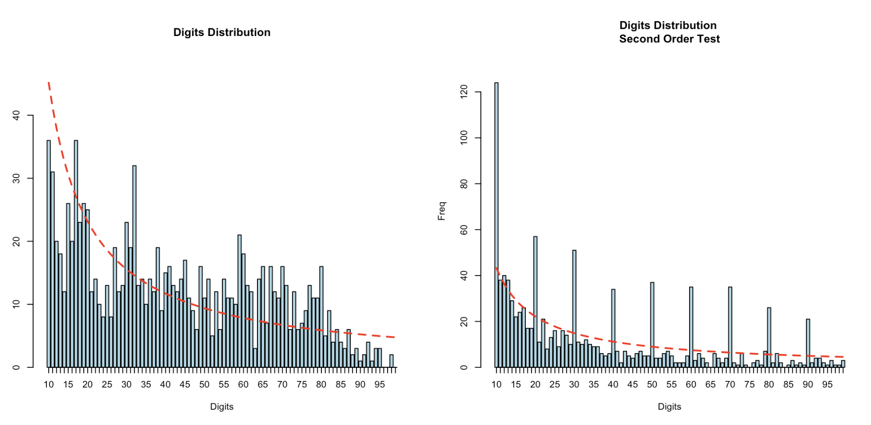
What does this look like?
These Graphs were made from the Benford.Analysis package for the first 2 digits of Walmart's data.

Slide 28
Bibliography:
Bloomenthal, A. (2011, July 20). Detecting financial statement fraud. Investopedia. https://www.investopedia.com/articles/financial-theory/11/detecting-financial-fraud.asp
Chang, J. C. (2017). A Study Of Benford’s Law, With Applications To The Analysis of Corporate Financial Statements. University of Nebraska. https://etda.libraries.psu.edu/files/final_submissions/14504.
Costco Wholesale Corporation (COST) stock historical prices & data - Yahoo Finance. (n.d.).
Retrieved February 19, 2023, from https://finance.yahoo.com/quote/COST/history/

Slide 29
Bibliography Continued:
Mergent Online - As reported : Costco Wholesale Corp. (n.d.). https://www.mergentonline.com/companyfinancials.php? pagetype=asreported&compnumber=16720 &period=Quarters&dataarea=BS&range=50¤cy=AsRep&scale=AsRep&Submit=Refresh&csrftokenmol=a60a01f7ec
Mergent Online – As reported : Walmart Inc. (n.d.) (2023, October).
Retrieved February 11, 2023, from https://www.mergentonline.com/companyfinancials.php?compnumber=8865

Slide 30
Bibliography Continued:
SEC.gov | Financial Statement Data sets. (2009, January 1).
Retrieved February 11, 2023, from https://www.sec.gov/dera/data/financial-statement-data-sets
SEC.gov - How to read an 8-K. (2021, January 26).
Retrieved February 11, 2023 from https://www.sec.gov/oiea/investor-alerts-and-bulletins/how-read-an8-k
Tamplin, T. (2022, December 26). Is current assets the same as total assets? Finance Strategists. https://www.financestrategists.com/accounting/financial-statements/balance-sheet/current-assets/is-current-assets-the-same-as-total-assets/

Slide 31
Bibliography Continued:
Walmart Inc. (WMT). (n.d.). Yahoo.com. Retrieved March 2, 2024, from https://finance.yahoo.com/quote/WMT?.tsrc=fin-srch
Full dividend history. (n.d.). Walmart.com. Retrieved March 2, 2024, from https://stock.walmart.com/stock-information/dividend-history/full-dividend-history/
St, S. W. (2019, July 1). A note on Walmart inc.’s (NYSE:WMT) ROE and debt to equity. Yahoo Finance. https://finance.yahoo.com/news/note-walmart-inc-nyse-wmt-095520157.html

